Slide 2
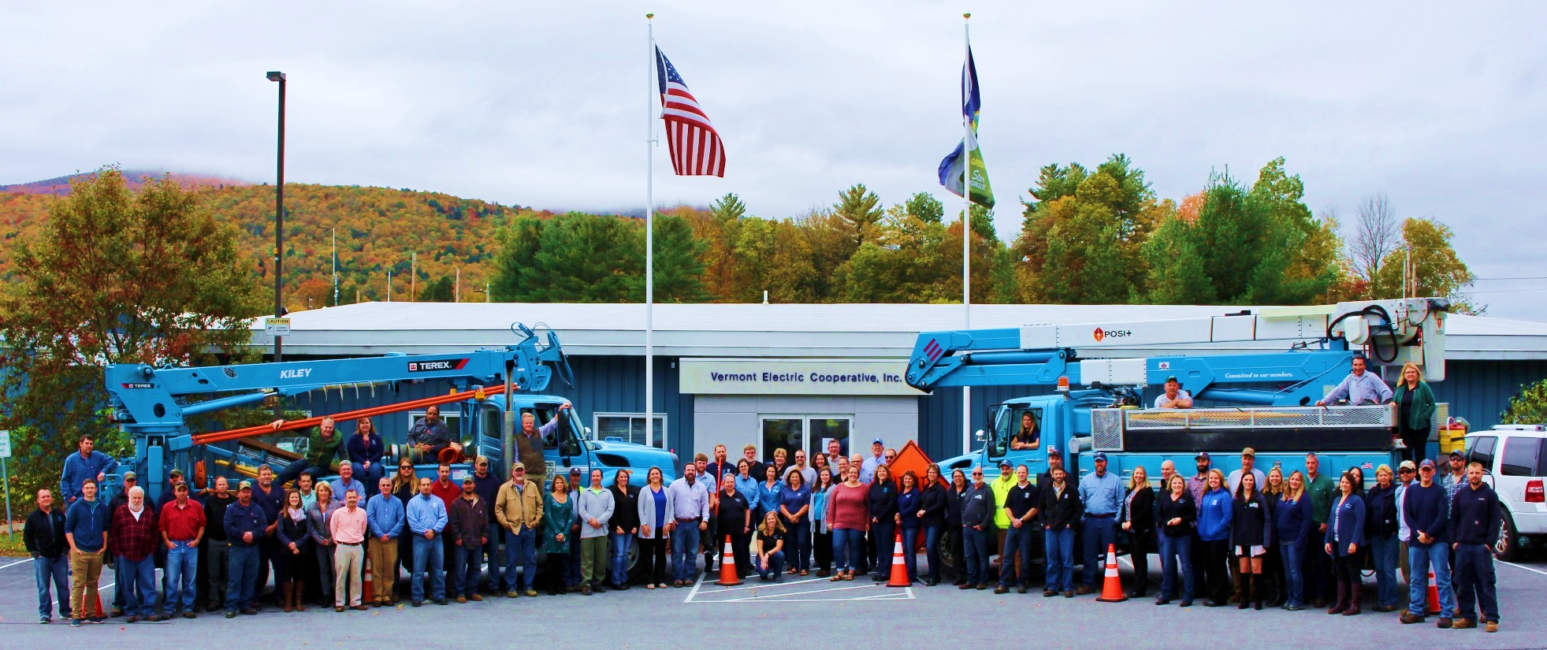
TREASURER’S REPORT
Notes:
I would like to wrap up by thanking our board and our employees for all of their good work.
Specifically I would like to thank board chair Dan Carswell for his many years of service and important leadership of VEC, including leading the charge to find a new CEO which I thought he did quite well.
I would also like to thank the team who put together this annual meeting. IT, member services, everyone who volunteered today but specifically our communications team Andrea Cohen, Lisa Morris and Jake Brown who made this day happen.
Finally thanks to each of you all for taking time out of your day to be here with us.
We value our member-input and I enjoyed so many wonderful conversations this morning. I hope each of you had a chance to laugh a little, learn a little and meet someone new today – a worthy start to a spring day.
I’m delighted I could be here with you and look forward to many more conversations in the future.

Slide 3
STRONG FINANCIAL RATING
Standard & Poor’s
A+ with stable outlook
Independent auditors reviewed and confirmed VEC 2019 financial results

Slide 4
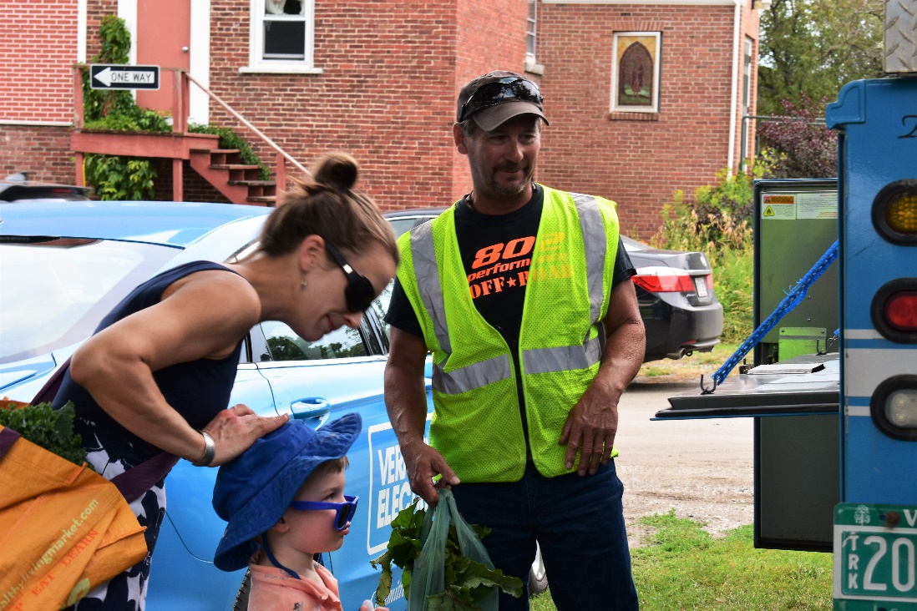
2019 FINANCIAL RESULTS
$77.1 Million operating revenues
$4.4 Million Net Income
Between 2013 and 2019 VEC has returned nearly $6.5 Million of patronage capital to members

Slide 5
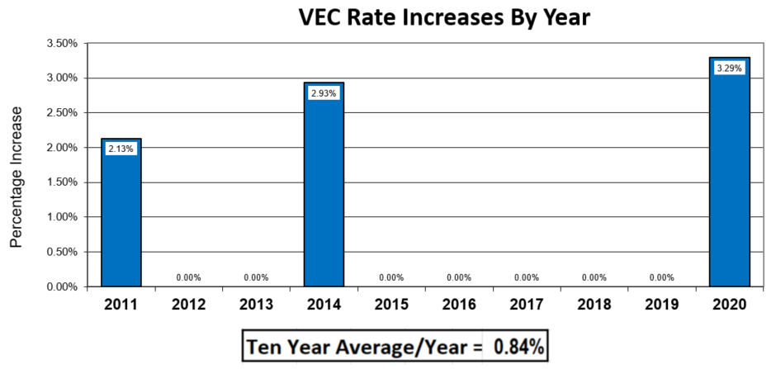
LOW RATE INCREASES

Slide 6
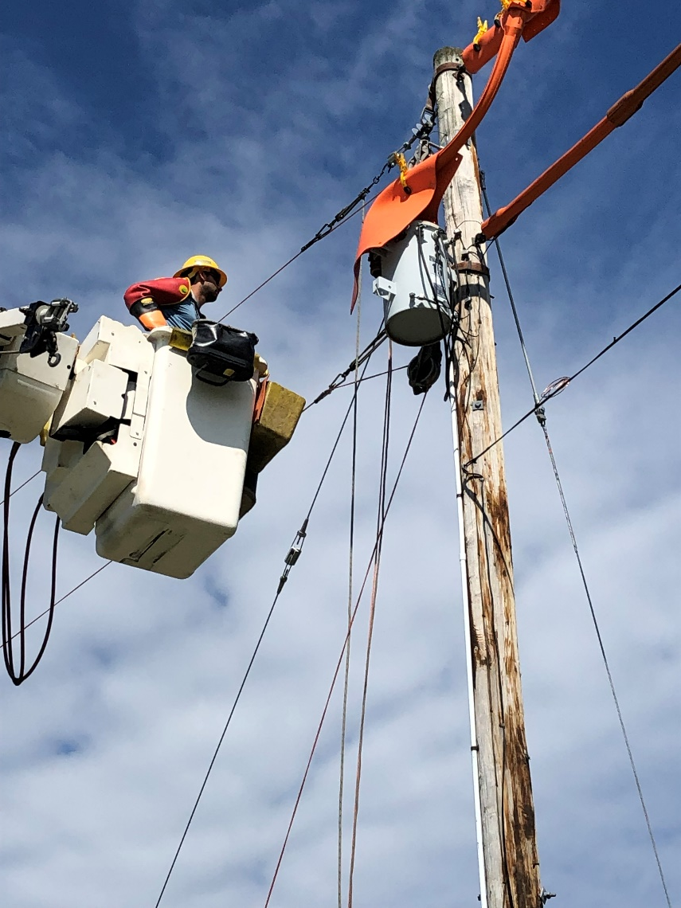
2019 FINANCIAL RESULTS
Capital Investments in 2019: $11.7 Million
Operating Expenses in 2019: $76.6 Million

Slide 7
Notes:
I would like to wrap up by thanking our board and our employees for all of their good work.
Specifically I would like to thank board chair Dan Carswell for his many years of service and important leadership of VEC, including leading the charge to find a new CEO which I thought he did quite well.
I would also like to thank the team who put together this annual meeting. IT, member services, everyone who volunteered today but specifically our communications team Andrea Cohen, Lisa Morris and Jake Brown who made this day happen.
Finally thanks to each of you all for taking time out of your day to be here with us.
We value our member-input and I enjoyed so many wonderful conversations this morning. I hope each of you had a chance to laugh a little, learn a little and meet someone new today – a worthy start to a spring day.
I’m delighted I could be here with you and look forward to many more conversations in the future.

Slide 8
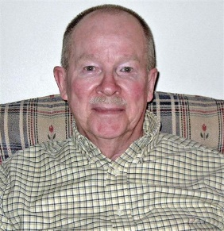
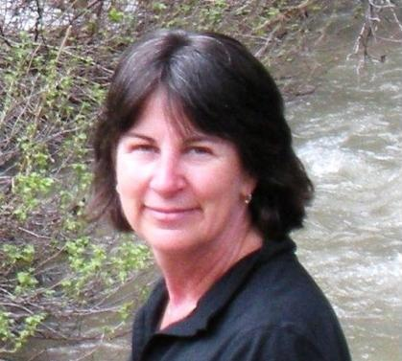
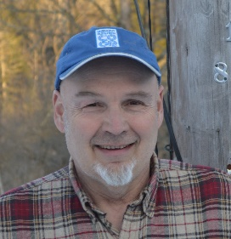
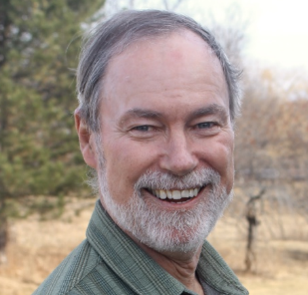
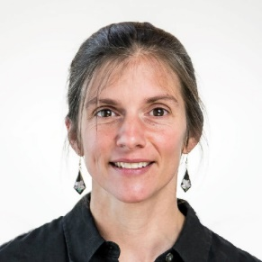
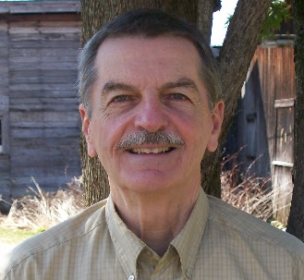
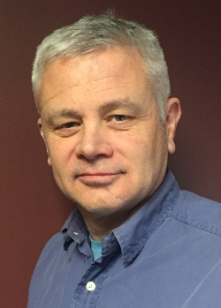
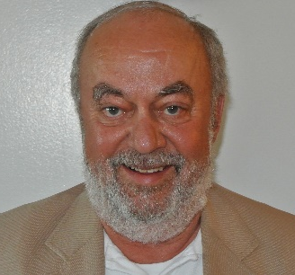
2019 Board of Directors
Don Worth
District 1
John Ward
District 2
Treasurer
Carol Maroni
District 3
2nd Vice President
Mark Woodward
District 4
Secretary
Charlie Van Winkle
District 5
Paul Lambert
District 6
1st Vice President
Rich Goggin
District 7
President
Jody Dunklee
Ken Hoeppner
Rich Westman
Thomas Bailey
George Lague
West Zone At-large
East Zone At-large

Slide 9
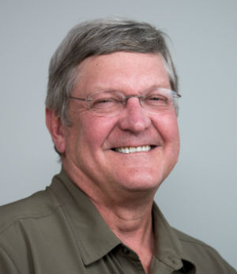
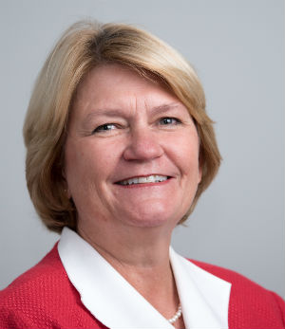
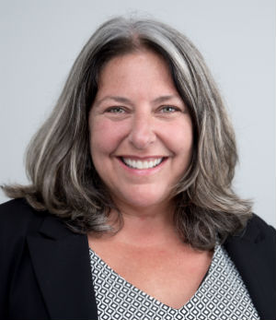
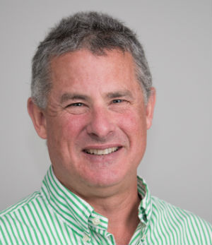
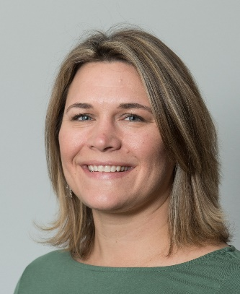
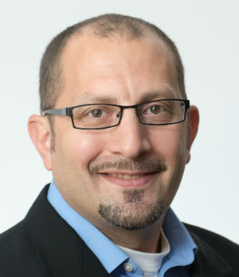
Senior Leadership Team
Andrea Cohen
Manager of Government Affairs and Member Relations
John Varney
Safety and Security Manager
Vickie Brown
General Counsel
Mike Bursell
Chief Financial Officer
Rebecca Towne
Chief Executive Officer
Peter Rossi
Chief Operations Officer

Slide 10
2019 Excellent Reliability

Slide 11
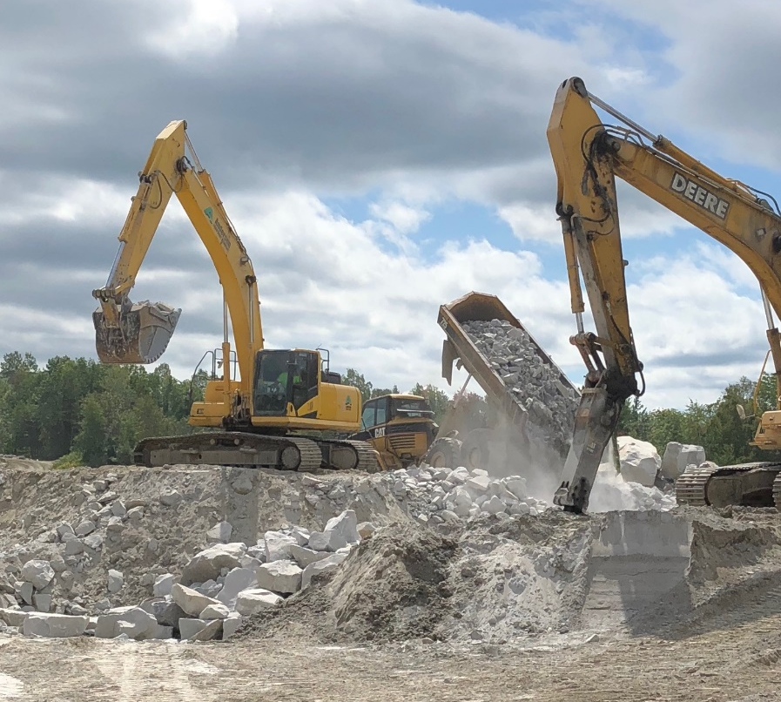
Energy Transformation
450 participants in 2019
Saving money & reducing carbon
Value to all members by using our infrastructure for more
Northeast Sand and Gravel
4 new sites connected by line extension

Slide 12
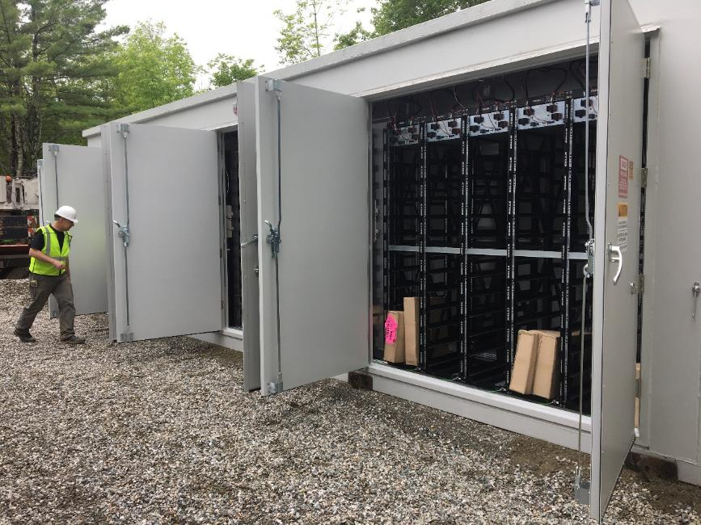
Utility-Scale battery in Hinesburg
1MW battery
Offsets peak energy usage
Savings ~$100,000 per year
Developing skill set in new technology

Slide 13
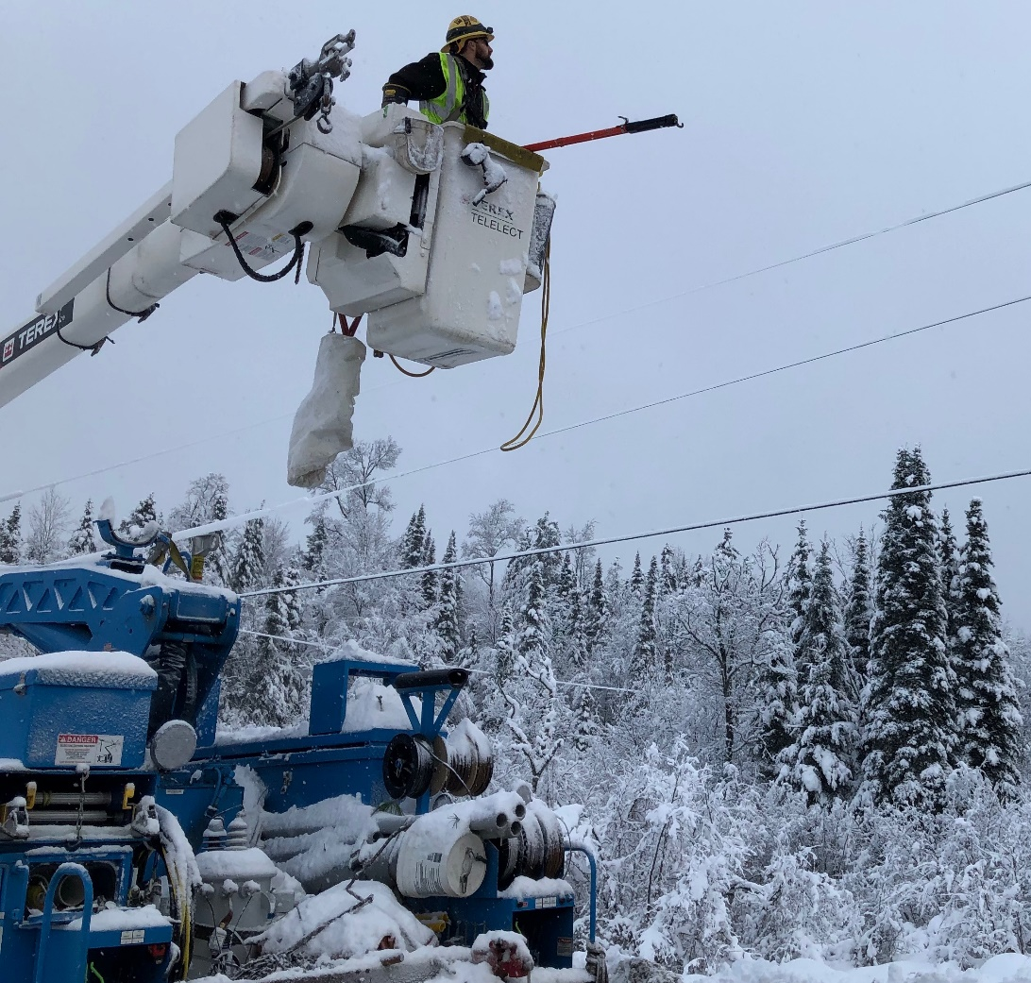
MISSION-FOCUSED
Vermont Electric Cooperative is a member-owned electric distribution utility that provides safe, affordable and reliable energy services to its members.

Slide 14
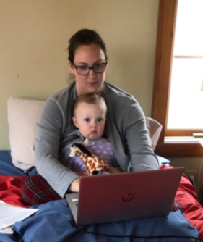
Online Tools for Members
Sign up for Smart Hub – online recurring bill payments, outage notification
Follow us on social media
Change to electronic delivery of Co-op Life

Slide 15
Broadband Feasibility Study
How can Vermont Electric Co-op best support broadband deployment to underserved areas in northern rural VT?
Vermont Broadband Innovation Grant
Partnerships in Vermont
How can VEC contribute?

Slide 16
Board of Directors
Election Results
District 7:
Rich Goggin 518 votes - 100%
East Zone At-Large:
George Lague 1054 votes - 71.2%
Normand Raymond 426 votes - 28.8%
West Zone At-Large:
Jeff Forward 757 votes - 38.3%
Ken Hoeppner 846 votes - 42.8%
Bill Karstens 372 votes - 18.8%

Slide 17
Bylaw Change
Approved
Amends Article V, Section 6 to allow Directors to vote and receive compensation when participating in a regular Board meeting via phone or videoconference.
There were 3037 votes in favor.
There were 295 votes opposed.

